Slide 1
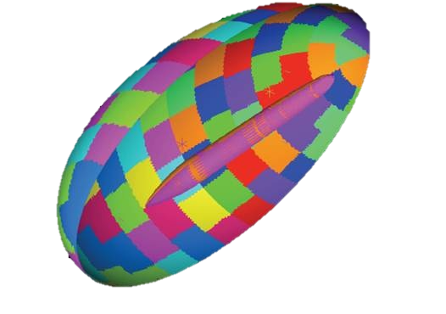
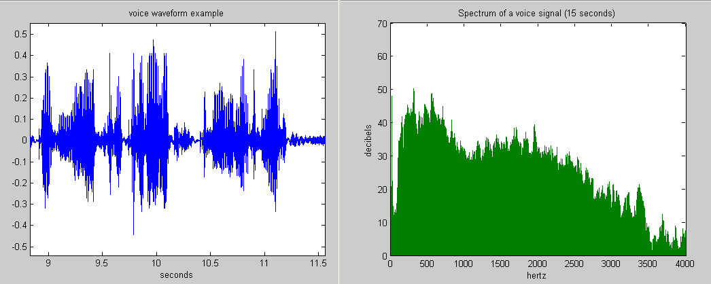

Performance of Modal Random Vibration Calculations for Structural Dynamics on Heterogeneous Computing Architectures
Julia Plews and Nathan Crane
Computational Solid Mechanics & Structural Dynamics Sandia National Laboratories
Trilinos User-Developer Group Meeting 2023
October 30-November 2, 2023
SAND2023-11591PE

Slide 2
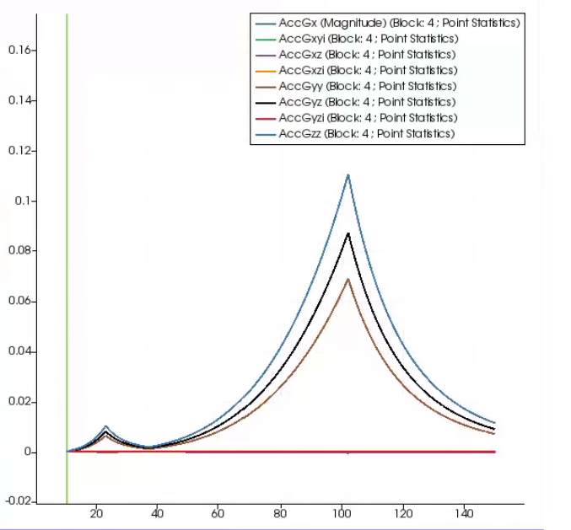
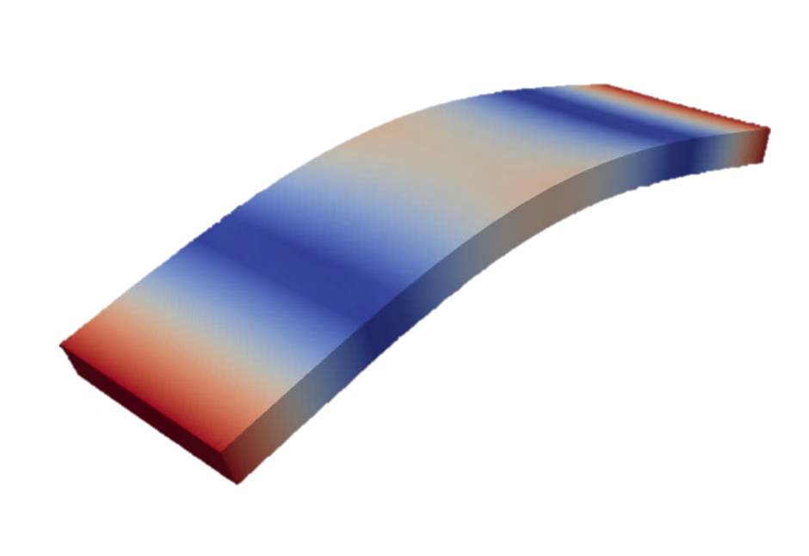
What is Modal Random Vibration?
Modal random vibration is a means to evaluate the statistical behavior of a structure in a steady-state vibration environment
Accel. Spectra
Frequency
Natural frequency mode shapes
Statistical description of input loads
Power spectra in frequency domain
Correlation between input loads
Statistical dynamic system behavior
Acceleration
Displacement
Stress
Image: https://en.wikipedia.org/wiki/Spectral_density

Slide 3
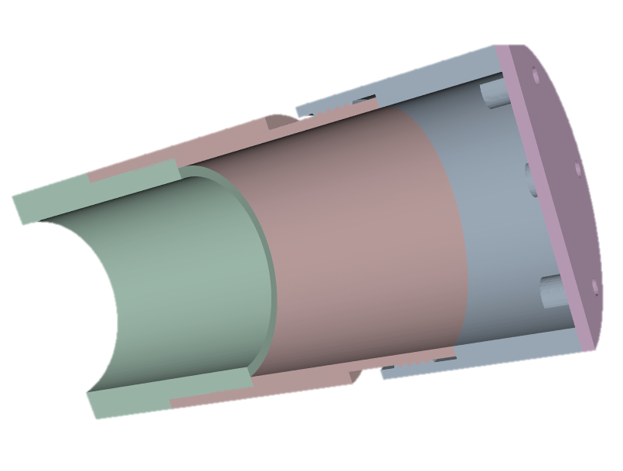

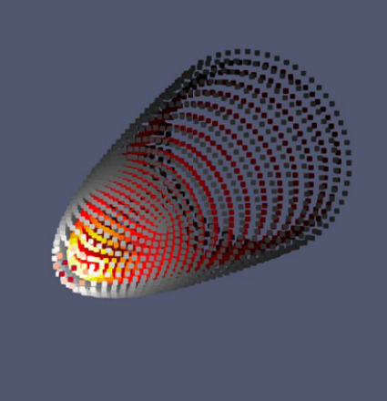
What is Modal Random Vibration?
An efficient alternative to performing large ensembles of transient structural analyses to understand response of structures under random excitation in environments such as
Typical probabilistic quantities of interest include
margin to material yield,
acceleration spectra near or inside a structural component,
fatigue crack initiation and growth, etc.
Transportation
Flight and atmospheric reentry
Test fixtures and experimental configurations

Slide 4
Modal Random Vibration mathematics
S(ω) = Z(ω)_{modes x loads} E(ω)_{loads x loads} Z^{T}(ω)_{loads x modes}
A(ω) = H*(ω)_{modes} S(ω)_{modes x modes} H(ω)_{modes}
ω = response frequency
A(ω) = response output (maybe complex-valued)
H(ω) = transfer function (complex-valued)
S(ω) = modal input power spectrum (complex-valued)
Z(ω) = modal excitation for load (real-valued)
E(ω) = input load magnitudes and correlations (complex-valued, input)
Typically engineers deal with up to thousands each of modes, loads, frequencies, and output locations, yielding possibly trillions of computations for a single simulation
An opportunity to utilize novel high-performance computing platforms to drastically reduce simulation turnaround times

Slide 5
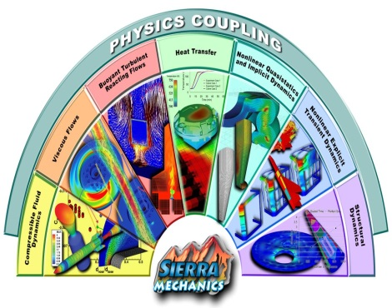

Sierra Structural Dynamics simulations at Sandia
Sierra/SD (Structural Dynamics): massively parallel C++ finite element analysis code in the Sierra suite of tools
In development for 25+ years
Designed to run on the fastest supercomputers in the world featuring CPU and GPU acceleration
Support national security missions
SD simulations are used to predict the behavior of a wide variety of systems, components, and experimental configurations

Slide 6

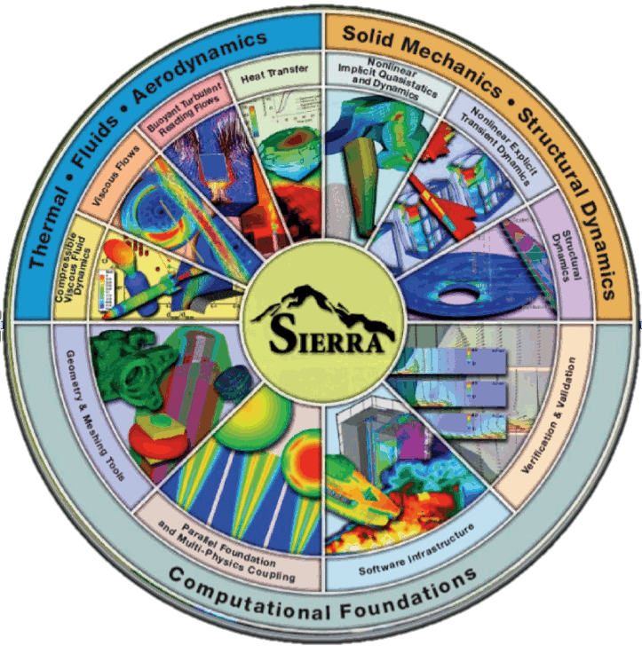
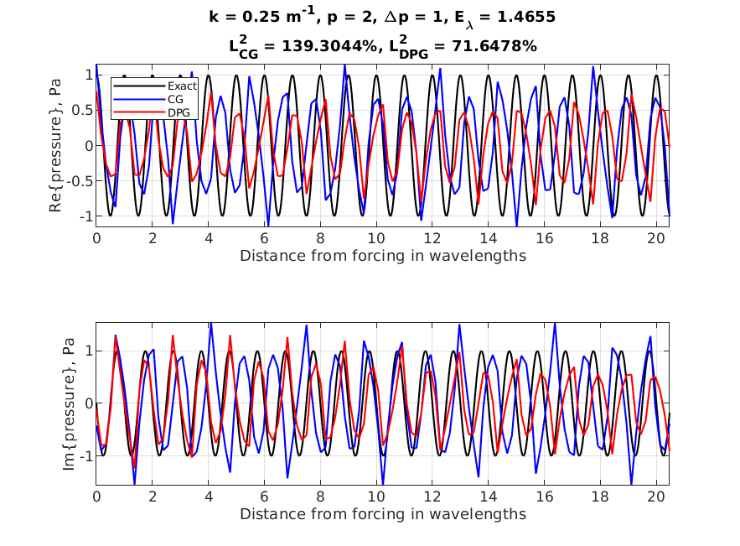

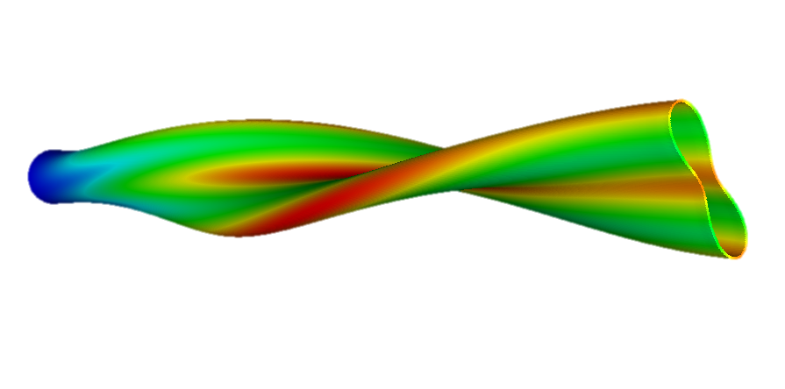
Computational science and engineering research for success in large SD simulations
Computational Science Tools
Computing Research
Engineering Analysis Tool Development
Analytical and Experimental Structural Dynamics
Engineering Sciences

Slide 7

Porting Sierra/SD to GPUs: Kokkos performance portability library
Sandia-developed C++ Performance Portability Programming EcoSystem¹
Write algorithms just once, execute on any architecture
struct MyKernel
{
void operator()(const size_t i) const {
printf("Hello, world!\n");
myGpuData(i) = 2 * i;
}
Kokkos::View<double*> myGpuData;
};
Kokkos::parallel_for(1024, MyKernel());
Kokkos::View<double*, Kokkos::CudaSpace> v("myData", 1024);
auto vHost = Kokkos::create_mirror(v);
... // do work on vHost
Kokkos::deep_copy(v, vHost);
Automatically move data between memory spaces (e.g., CUDA to host and back)
KokkosBlas::gemm(Sal::ExecSpace(), "N", "N", 1.0, Z, Eij, 0.0, Z_times_E);
KokkosBlas::gemm(Sal::ExecSpace(), "N", "C", 1.0, ZtimesE, Z, 0.0, Sij);
Execute kernels in parallel through a tailored template interface
Provide an agnostic interface to vendor-supplied linear algebra operations (e.g., cuBlas)
Kokkos on Github: https://github.com/kokkos
Kokkos: Enabling manycore performance portability through polymorphic memory access patterns
H. C. Edwards , C. R. Trott , D. Sunderland, Kokkos, J. Parallel and Distributed Computing, v.74 n.12, p.3202-3216, Dec. 2014

Slide 8
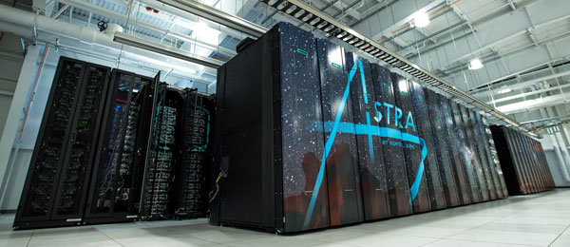
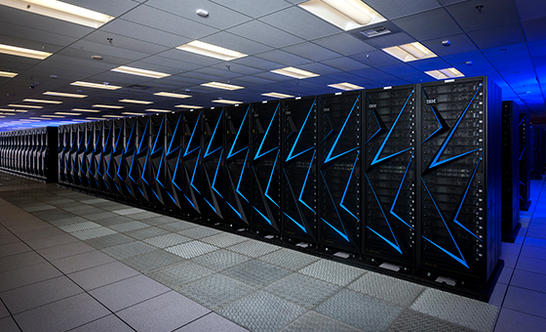
Historical performance of Modal Random Vibration in Sierra/SD
Exemplar model performance: Medium-fidelity simulation of vibration of a system in atmospheric reentry environment
ARM platform: “Astra,” 28 cores x 2 sockets Cavium Thunder-X2 per node
(*data labels are speedups)
2015: Historical performance, CPU only
2019: Initial Kokkos port to both ARM and GPU
2022: First attempt at GPU optimization (lessons learned!)
2023: Second, successful attempt at GPU optimization based on KokkosKernels
GPU platform: “Sierra,” 44 cores IBM Power9 + 4x NVIDIA V100 per node
Notes:
Initial model ~10000 seconds to run

Slide 9
Historical performance of Modal Random Vibration in Sierra/SD
2019: Initial port to GPU and ARM based on Kokkos
Focused on a single performance hotspot: nodal output at each frequency
Overall complexity O(frequencies * nodes * modes²)
GPU parallelization only over nodes; O(1000) concurrency insufficient to saturate GPU
Modal input power spectrum (S) calculation not ported to GPU
for (int i = 0; i < numFreq; ++i) {
Kokkos::parallel_for("NodalOutput", numNodes,
KOKKOS_LAMBDA(int j) {
outputVal(j) = Calc_H_S_Ht(H(j), S);
});
}
Serialized calculation per node
No observable performance benefit from GPU use: small concurrency and too many serialized computations

Slide 10
Historical performance of Modal Random Vibration in Sierra/SD
2021: (Unsuccessful) first attempt at GPU optimization
GPU optimization focused on calculation of matrix S (input power spectrum):
S = Z_{modes x loads} E_{loads x loads} Z^{T}_{loads x modes}
Kokkos “multi-dimensional range” to consolidate 4 nested loops
Kokkos::MDRangePolicy<Kokkos::Rank<4>> range({0, 0, 0, 0}, {nModes, nModes, nLoads, nLoads});
Kokkos::parallel_for(
"Scalc", range, KOKKOS_LAMBDA(int iMode, int jMode, int iLoad, int jLoad) {
unsigned iModeIdx = modeIndices(iMode);
unsigned jModeIdx = modeIndices(jMode);
Kokkos::atomic_add(&S(iModeIdx, jModeIdx),
Z(iModeIdx, iLoad) * E(iLoad, jLoad) * Z(jModeIdx, jLoad));
});
Accessing data at non-contiguous locations
O(modes² * loads²)
Performance actually degraded due to atomics, frequent data access indirection, and high operator complexity

Slide 11
Historical performance of Modal Random Vibration in Sierra/SD
2023: (Successful) second attempt at GPU optimization
S = Z_{modes x loads} E_{loads x loads} Z^{T}_{loads x modes}
Step one: remove modal data access indirection
RemoveInactiveModes(S);
RemoveInactiveModes(Z);
Kokkos::MDRangePolicy<Kokkos::Rank<4>> range({0, 0, 0, 0}, {nModes, nModes, nLoads, nLoads});
Kokkos::parallel_for(
"Scalc", range, KOKKOS_LAMBDA(int iMode, int jMode, int iLoad, int jLoad) {
Kokkos::atomic_add(&S(iMode, jMode),
Z(iMode, iLoad) * E(iLoad, jLoad) * Z(jMode, jLoad));
});
Data access is now contiguous, but complexity is still O(modes² * loads²)
Notes:
Notes: this high complexity operation lived in the code for many years and was brought to the fore as a hot spot by attempted Kokkos optimizations

Slide 12
Historical performance of Modal Random Vibration in Sierra/SD
2023: (Successful) second attempt at GPU optimization
ZE = Z_{modes x loads} E_{loads x loads}
S = ZE_{modes x loads} Z^{T}_{loads x modes}
Step two: introduce temporary product, use performance-portable BLAS provided by KokkosKernels (optimized dense linear algebra)
RemoveInactiveModes(S);
RemoveInactiveModes(Z);
KokkosBlas::gemm(ExecSpace(), "N", "N", 1.0, Z, E, 0.0, ZtimesE);
KokkosBlas::gemm(ExecSpace(), "N", "C", 1.0, ZtimesE, Z, 0.0, S);
Cleaner code, lower O(modes² * loads) complexity, and truly performance-portable
Notes:
Notes:
this complexity flew under the radar for many years due to lack of large performance tests like what analysts typically run
Optimized BLAS routines are likely faster than any hand-rolled computations

Slide 13
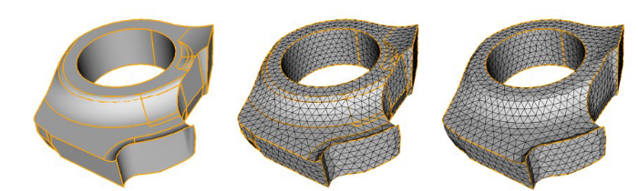
Summary and impacts on statistical analysis of structures at Sandia
 | Spring 2022 baseline | Fall 2022 | Spring 2023
CPU | -- | ~3x slower than Spring 22 | ~4x faster than Spring 22
GPU | on par with CPU | ~1.2x slower than Spring 22 on CPU | ~12x faster than Spring 22 on CPU
Performance changes in actual SD analyst model, relative to Spring 2022 version of Sierra/SD on CPU HPC platform
Through a combination of
advances in GPU architectures,
convenient code porting utilities,
and algorithm optimizations,
modal random vibration computations in Sierra/SD that used to take days may now take minutes, enabling statistical analyses of structural designs in real time

